Slide 1
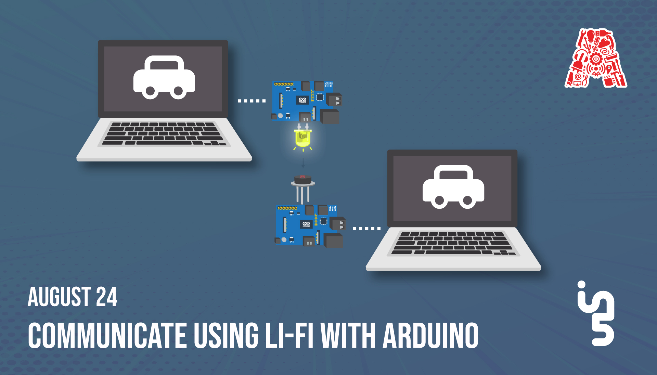

Slide 2
About the Assembly
A smart lab based out of In5 since Dec 2014
Over 250 free workshops done
ASSEMBLY: HACK - Embedded systems, iOT and hardware
ASSEMBLY: CODE - Software projects - APIs, frameworks, apps
Age range: 16-60 - students, professionals, entrepreneurs
Focus on smart technology and practical applications
Forum: members.theassembly.ae

Slide 3
TAG US ON OUR SOCIAL MEDIA
FACEBOOK
TWITTER
INSTAGRAM
YOUTUBE
The Assembly (@MakeSmartThings)
@MakeSmartThings
@MakeSmartThings
The Assembly

Slide 4

Overview
TOPICS:
Introduction To Li-Fi
Advantages and Disadvantages of Li-Fi
Comparison with Wi-Fi
Future scope of Li-fi
Dependencies
Components
Li-Fi using Light
Li-Fi using Infrared
Fun Fact

Slide 5
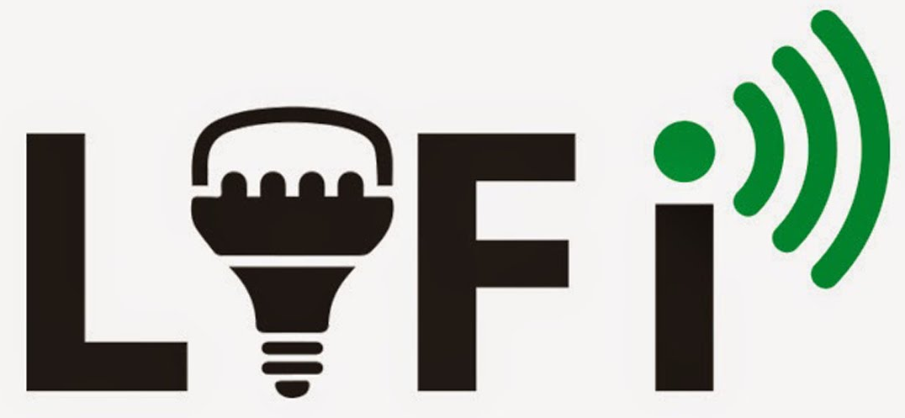
Introduction to Li-Fi
Light Fidelity
Li-Fi is a wireless communication technology, which utilizes light to transmit data and position between devices.
Li-Fi is a light communication system that is capable of transmitting data at high speeds over the visible light, ultraviolet, and infrared spectrums.
Mac OS 10.14

Slide 6
Advantages and Disadvantages of Li-Fi
Advantages | Disadvantages
Good Security | Limited Range
It is very efficient in terms of cost and energy. | Limitation in usage of light sources
Unimpeded by radio interference. | Interference from other light sources
Mac OS 10.14
Notes:
Advantages:-
Security : Since light cannot pass through opaque structures, Li-Fi Internet is available only to the users within a room and cannot be breached by users in other rooms or buildings.
Efficiency: Since homes and offices already have LED bulbs for lighting purposes, the same source of light can be used to transmit data. Hence, it is very efficient in terms of costs as well as energy.
Li-Fi also has an advantage of being immune from electromagnetic interferences that affect radio-based wireless communication technologies.
Disadvantages:-
Because it uses visible light, and light cannot penetrate walls, the signal's range is limited by physical barriers.
Internet cannot be used without a light source. This could limit the locations and situations in which Li-Fi could be used.
Sunlight and other light sources could interfere with the signals, resulting in interrupted Internet.

Slide 7
Comparison of Li-Fi and Wi-Fi
Features | Li-Fi | Wi-Fi
Full Form | Light Fidelity | Wireless Fidelity
Operation | Transmits data using light with the help of LED bulbs | Transmits data using radio waves with the help of a Wi-Fi router
Interferences | From other light sources | From nearby access points
Mediums | Can pass through salty sea water, works in densy region | Cannot pass through sea water, works in less densy region
Data Transfer Speed | About 1Gbps | WLAN-11n offers 150Mbps , About 1-2 Gbps can be achieved using WiGig/Giga-IR
Applications | Used in airlines, operation theaters, offices and homes | Used for internet browsing with the help of Wi-Fi hotspots
Mac OS 10.14

Slide 8
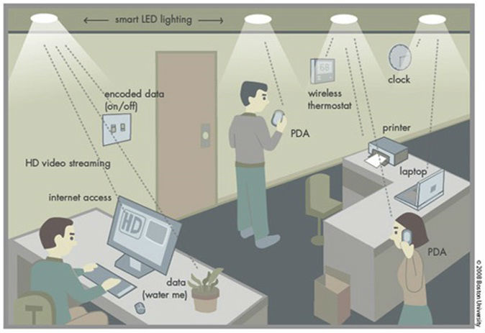
Future scope of Li-Fi
Home Automation
It is predicted that future home and building automation will be highly dependent on the Li-Fi technology for being secure and fast. As the light cannot penetrate through walls, the signal cannot be hacked from a remote location.
Advertising
A customer walking into a store and passing through the store's front lights can show current sales and promotions on the customer's cellular device.
Mac OS 10.14

Slide 9


Dependencies
Download the files from GitHub
https://github.com/The-Assembly/LiFi
Download Arduino Software:
https://www.arduino.cc/en/Main/Software

Slide 10
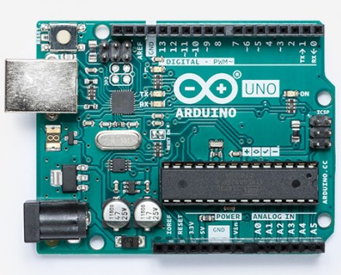
Components
Arduino Uno
The Arduino UNO is an open-source microcontroller board.
Microcontroller: ATmega328
Operating Voltage: 5V
Input Voltage (recommended): 7-12V
Input Voltage (limits): 6-20V
Digital I/O Pins: 14 (of which 6 provide PWM output)
Analog Input Pins: 6
Flash Memory: 32 KB of which 0.5 KB used by bootloader
Mac OS 10.14
Notes:
Flash memory is a Non volatile memory thus the data will not be lost even after power is switched off.
Bootloader is a piece of code that runs before any operating system is running.
Bootloader are used to boot other operating systems, usually each operating system has a set of bootloaders specific for it.

Slide 11
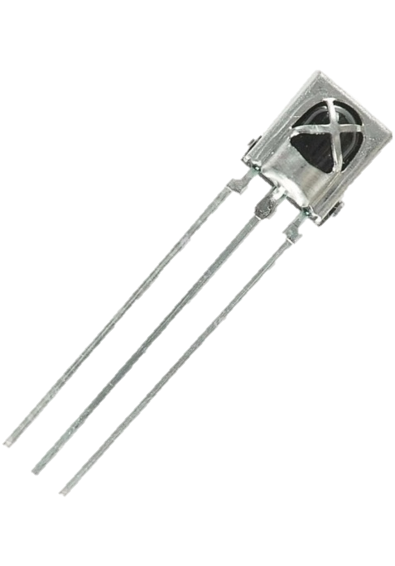
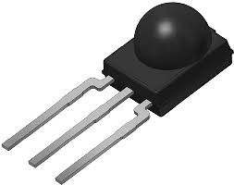
Components
TSOP532/VS1838B Infrared Receiver module
Operating Voltage 2.7 to 5.5V
Operating Current 0.4 to 1.5mA
Reception Distance 18m
Reception Angle ±45º
Carrier Frequency 38KHz
Low Level Voltage 0.4V
High Level Voltage 4.5V
2
3
1
1
2
3
Pinout:
OUT
GND
VCC

Slide 12
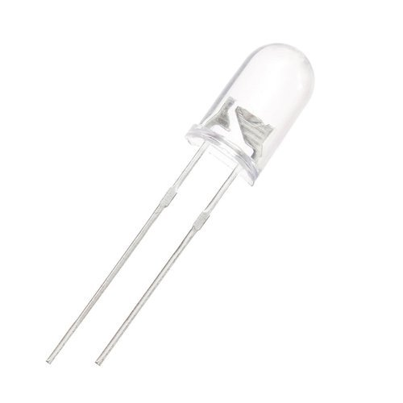
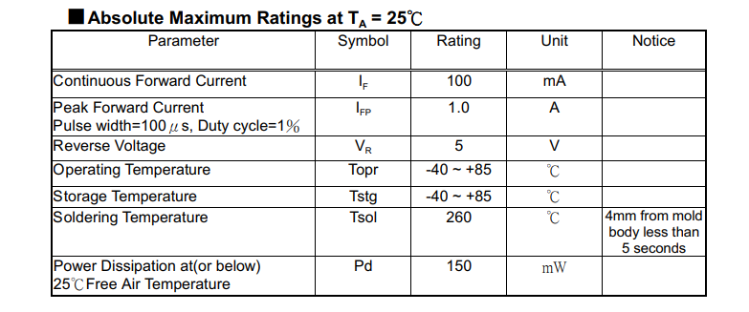
Components
Infrared transmitter
Mac OS 10.14

Slide 13
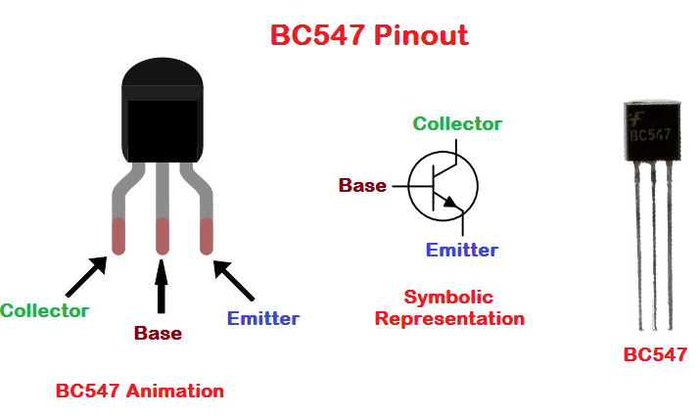
Components
Bipolar Junction Transistor
It is used for current amplification
Transistor Type - NPN
Voltage - Collector Emitter Breakdown (Max) - 45V
Current - Collector (Ic) (Max) - 100mA
Power - Max 625mW
Mac OS 10.14

Slide 14
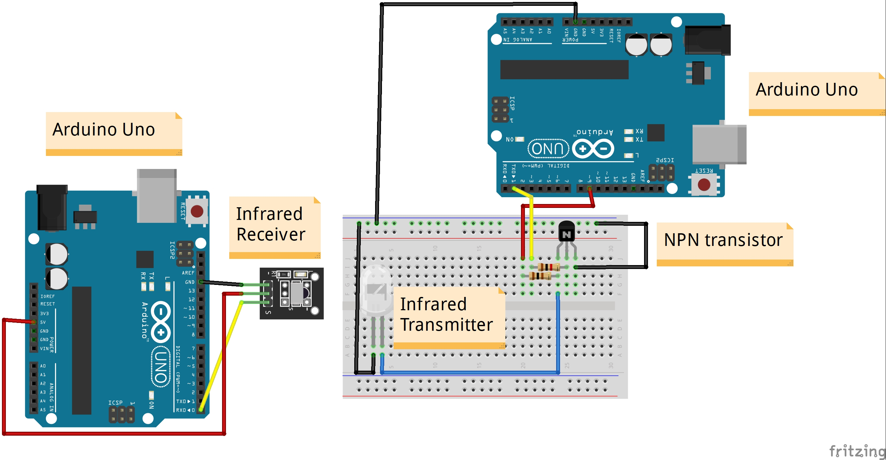
Li-Fi using Infrared - Circuit
Mac OS 10.14

Slide 15
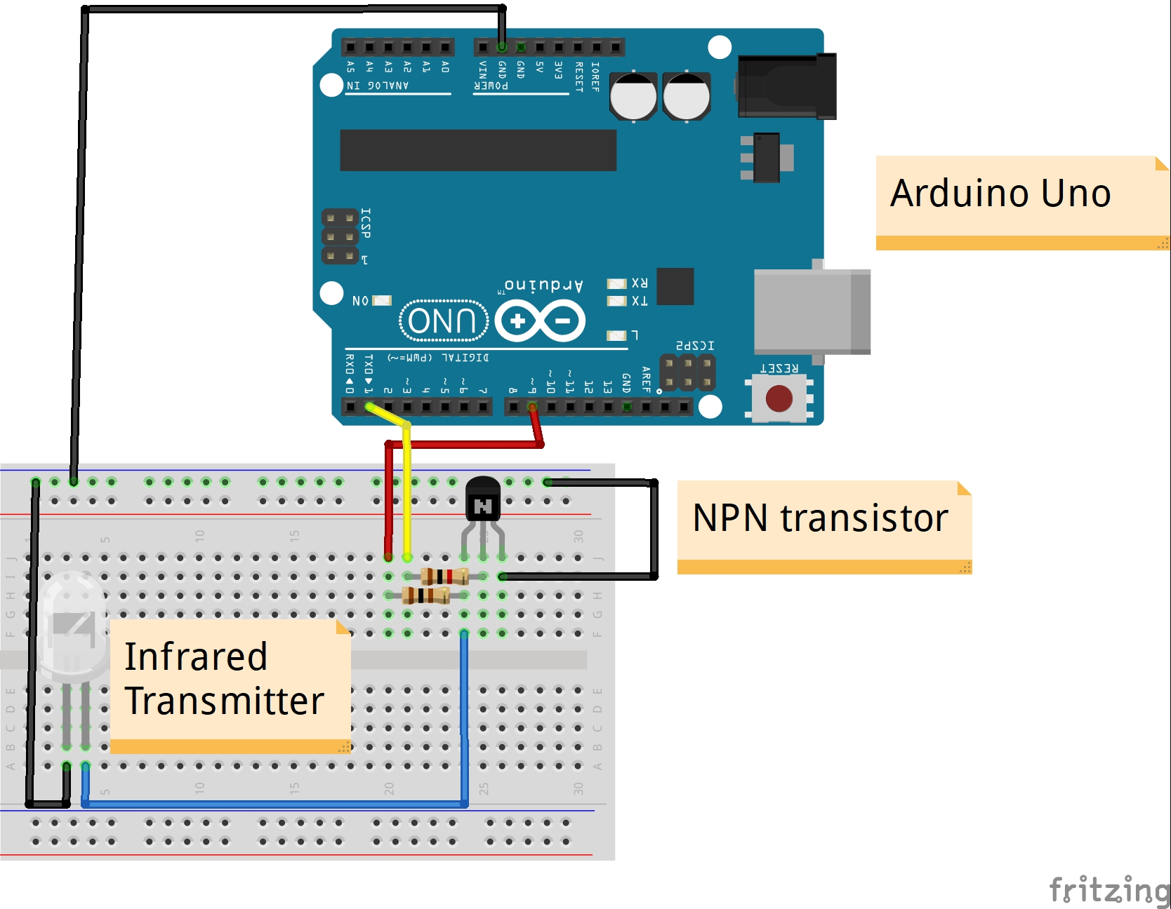
Li-Fi using Infrared - Circuit
Mac OS 10.14

Slide 16
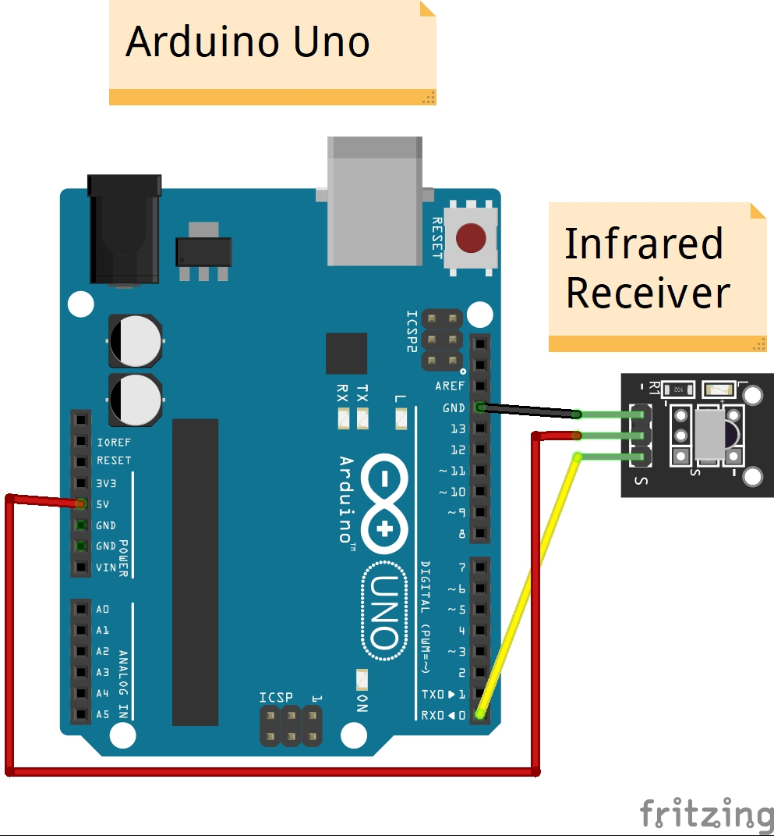
Li-Fi using Infrared - Circuit
Mac OS 10.14

Slide 17
Li-Fi using Infrared - Code
The code for the transmitter side:
void setup() {
Serial.begin(1200); /* Define baud rate for serial communication */
}
void loop() {
if(Serial.available()) /* If data is available on serial port */
{
Serial.print(char(Serial.read())); /* Print character received on to the serial monitor */
}
}
Mac OS 10.14

Slide 18
Li-Fi using Infrared - Code
The code for the receiver side:
#define cr_pin 9
void setup() {
Serial.begin(1200); /* Define baud rate for serial communication */
tone(cr_pin, 38000); /* For modulation at 38kHz */
}
void loop() {
String incomingByte;
incomingByte = Serial.readString();
if (incomingByte != -1) {
Serial.println(incomingByte);
}
//delay(1000);
}
Mac OS 10.14

Slide 19
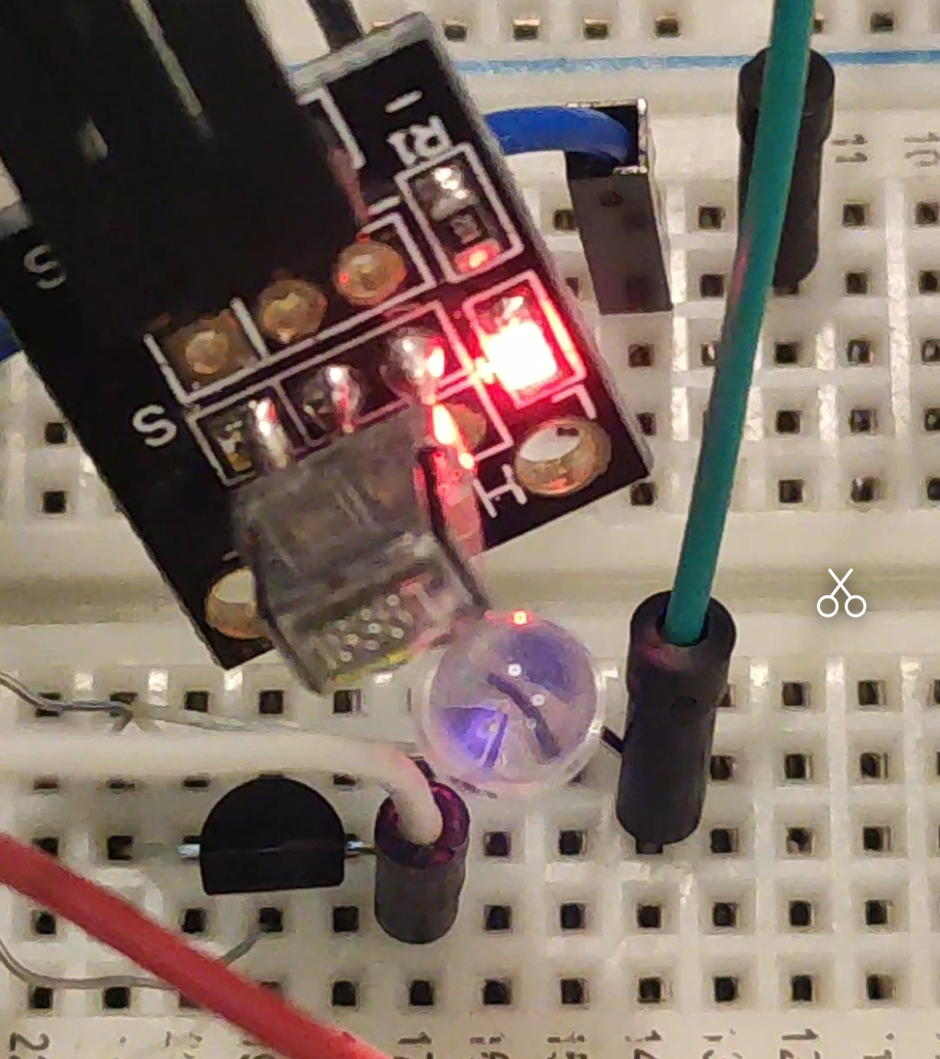
Fun Fact
Our eyes cannot see the Infrared Light, but digital cameras surely can. A smartphone's camera is indeed sensitive to IR radiation .
Majority of iPhone's main camera cannot see infrared light, because Apple added a filter over the lens that blocks out infrared light, so the infrared light cannot be seen on the screen.
The Infrared light is the purple light
Mac OS 10.14

Slide 20
THANK YOU!

